Slide 1
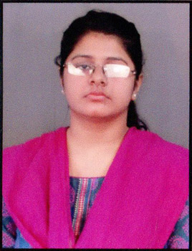
Pipsita Moharana
Email
Phone
Location
LinkedIn
:pipsita.moharana@zensar.com
: +91 7205835118
: Bangalore
: Pipsita Moharana
Personal & Professional details
Key projects & achievements
Role & experience
Guidewire developer with 3.9 years of professional experience well versed in different areas of development right from requirement gathering, Planning, estimation and Implementation
SafeAuto– GWPC Developer (01-21 to Till Date)
Involved in the Development for a complex integration flow which had changes from integration as well as config side. Areas like UI /PCF, System Table, Product Model, Data Model, Rest Service etc. are covered as part of the changes.
Worked on Major items like creation of new Contingency and its end-to-end flow, configuration of coverage messaging per the logic
Identified existing issues and provided the fix for them
Education
BSc. Comp. Sc. Horns.
2014-2017
Core competencies
Category | Skills | Exp (yrs) | Details
Vertical | ADS-Insurance | 3.9 | Served 2 clients
Domain | Insurance | 3.9 | Various responsibilities in Software development
Tools | SQL Server, SOAP, POSTMAN, ORACLE, JIRA, GWPC | 3.9 | Effectively used tools through out for project delivery
US Based Major Insurance Carrier – GWPC Developer
(10-17 to 12-20)
Worked on major UI configuration such as Coverage Configuration, Data Model Design for Enhancements.
Created batches which helped in lowering the manual effort
Created new forms and documents in PolicyCenter which helped client to be compliant Stepped up to fix critical environmental related bug
Identified the impacted policies for given criteria, Prepared the script to perform clean up on the policies
Certifications
Scrum Foundation Professional Certificate
Achievements
Awarded as “Best Performer” 2 times by client, Received one Outstanding Award for the consistence performance
Employment History
Senior Software Engineer, Zensar [Jan 2021 – till data]
Developer , Deloitte (Oct 2017 – Dec 20202)

